Slide 1
Global mart Sales Forecasting Case Study
By Shruti Diwakar
Tarunay Roy
Swapnik C.
Rakesh M.

Slide 2
Business understanding
Global Mart is an online store super giant operating worldwide
It takes orders and delivers across the globe and deals with all the major product categories - consumer, corporate & home office
The store caters to 7 different market segments - Africa, APAC, Canada, EMEA, EU, LATAM, America and 3 major categories: Consumer, Corporate, Homeoffice.

Slide 3
Business objectives
There are 21 market buckets – 7 markets x 3 categories- and we have to identify the two most “consistently” profitable market bucket.
We have to forecast the sales for next 6 months for these 2 market buckets.

Slide 4
Problem Solving ApproacH:
Calculate COV and Sales to identify the most consistently profitable bucket
Business Understanding
Data Understanding
Data Cleansing and Formatting
Identify 21 buckets for analysis
Smoothen the curve before using Classical Decomposition
Alternatively use Auto.Arima for time series modelling
Smoothen the curve before using Classical Decomposition
Decompose and see the shape of trend and seasonality
Create monthly time Series data for modelling
Perform KPSS and ADF Tests for stationarity on Residuals
Choose the best model based on MAPE
Use the best model for forecasting sales for next 6 months

Slide 5
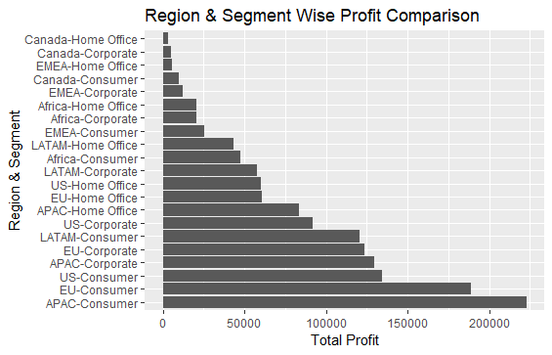
Profit comparison
We see APAC Region -Consumer Segment and EU Region- Consumer Segment has the highest profit among the 21 buckets

Slide 6
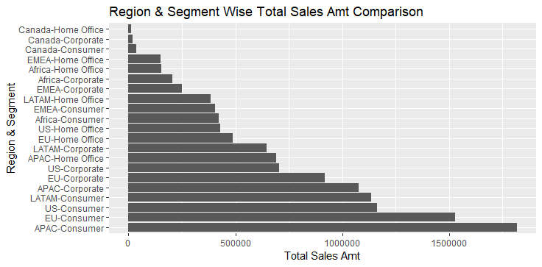
TOTAL SALES (AMT) comparison
We see APAC Region -Consumer Segment and EU Region- Consumer Segment has the highest sales (amt) among the 21 buckets

Slide 7
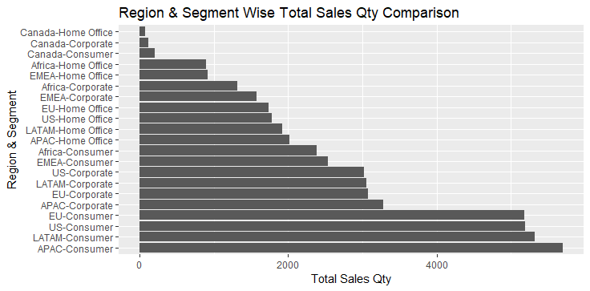
TOTAL SALES (Qty) comparison
We see APAC Region –Consumer Segment and LATAM Region- Consumer Segment has the highest sales (qty) among the 21 buckets

Slide 8
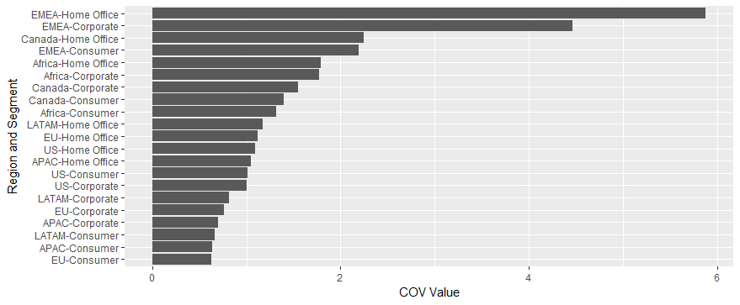
Two Content Layout with Table
First bullet point here
Second bullet point here
Third bullet point here

Slide 9
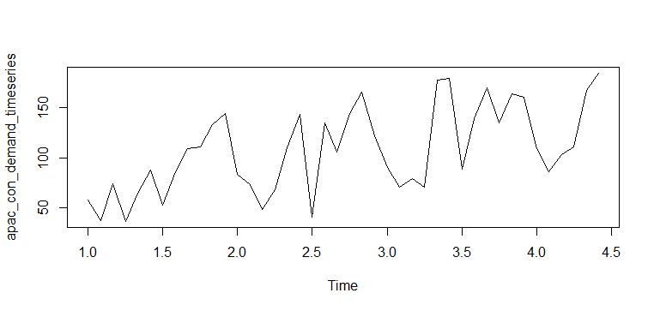
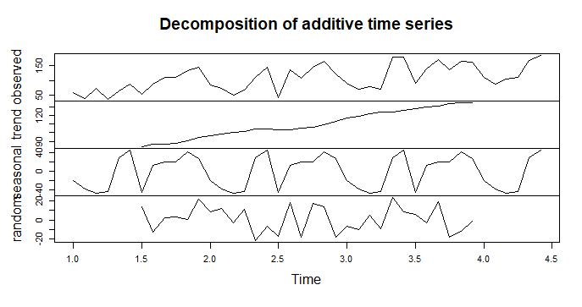
Decompose APAC SALES QTY Time series
The APAC Demand Time Series has additive components as seen from time series plot
The decomposed time series shows a linear trend and low amplitude sinusoidal seasonal behavior -40 to +40

Slide 10
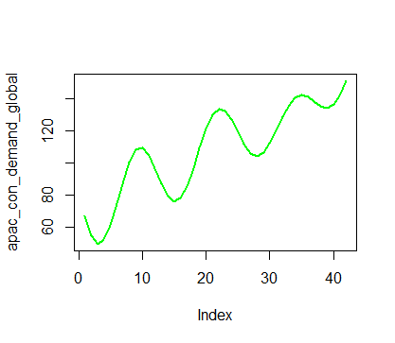
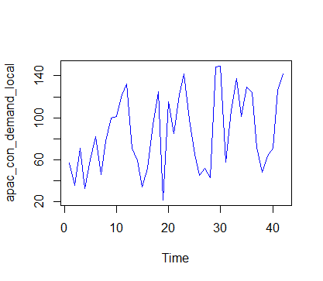
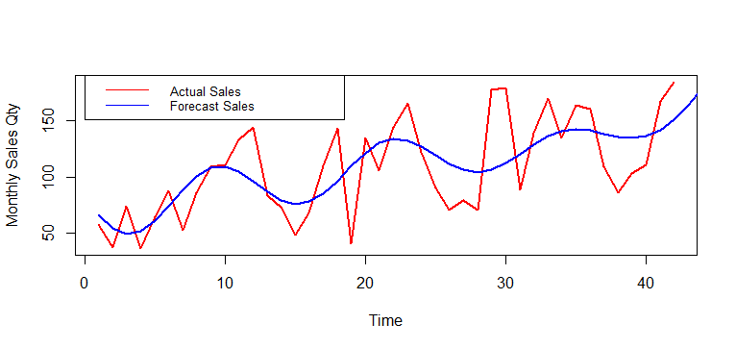
APAC SALES QTY FORECAsting:
Classical decomposition method:
The Global component shows increasing trend
The Local component shows seasonality
The Classical Decomposition method on Test set yielded a MAPE of 17.14%

Slide 11
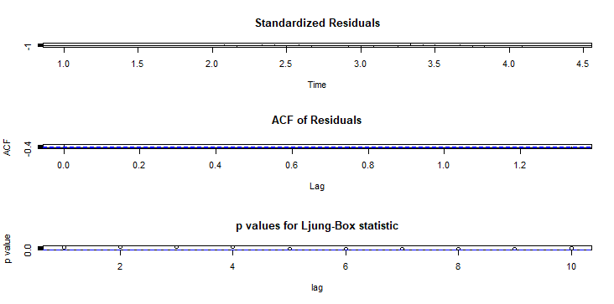
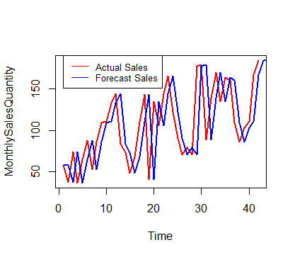
Apac sales qty AUTO ARIMA method:
The ARIMA method on Test set yielded a MAPE of 25.95%
The shift in the curve to the right can be due to the increased lag in response to demand.

Slide 12
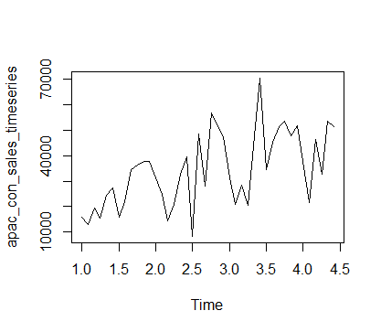
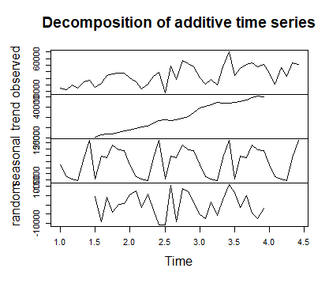
Decompose APAC SALES AMT Time series
The APAC Sales Time Series has additive components as seen from time series plot
The decomposed time series shows a linear trend and low amplitude sinusoidal seasonal behavior -15000 to 15000

Slide 13
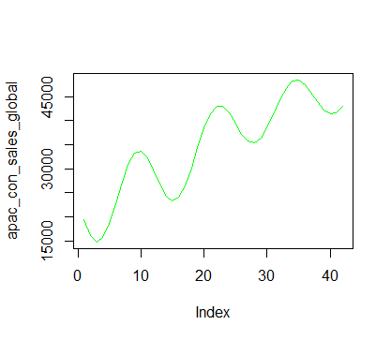
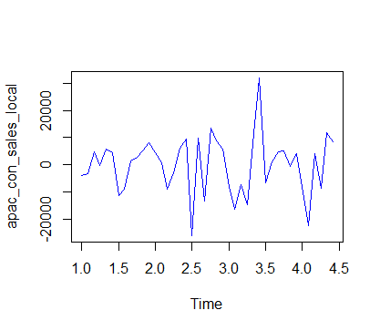
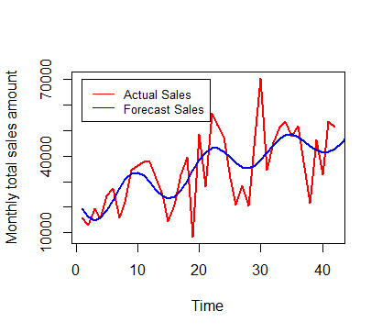
APAC SALES FORECAsting:
Classical decomposition method:
The Global component shows increasing trend
The Local component shows seasonality
The Classical Decomposition method on Test set yielded a MAPE of 22.5%

Slide 14
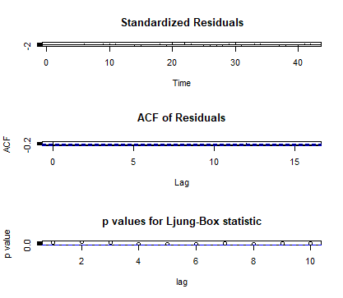
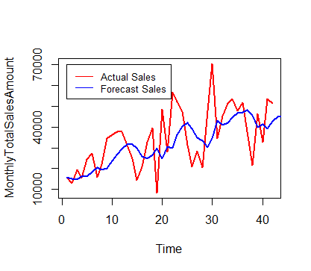
Apac sales AMT AUTO ARIMA method:
The ARIMA method on Test set yielded a MAPE of 27.68%
The residuals pass the stationarity tests.

Slide 15
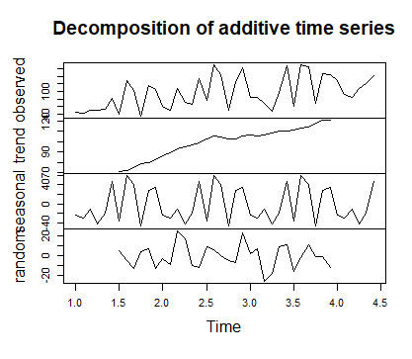
Decompose EU SALES QTY Time series
The EU Sales Qty Time Series has additive components as seen from time series plot
The decomposed time series shows a linear trend and low amplitude sinusoidal seasonal behaviour -40 to +40

Slide 16
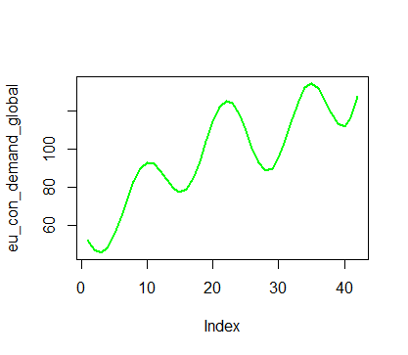
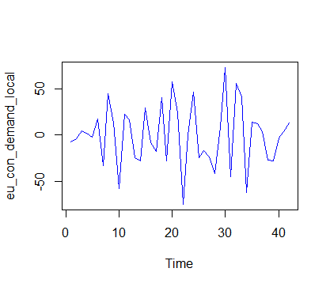
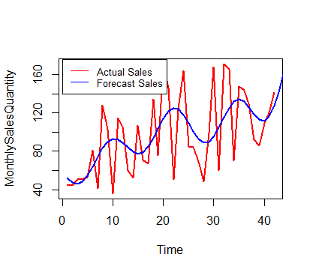
APAC SALES FORECAsting:
Classical decomposition method:
The Global component shows increasing trend
The Local component shows seasonality
The Classical Decomposition method on Test set yielded a MAPE of 22.98%

Slide 17

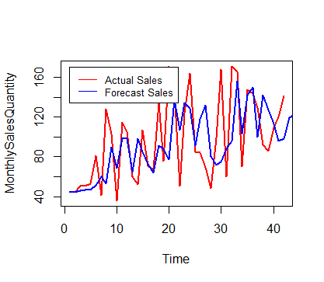
EU sales AMT AUTO ARIMA method:
The ARIMA method on Test set yielded a MAPE of 29.01%
The residuals pass the stationarity tests

Slide 18
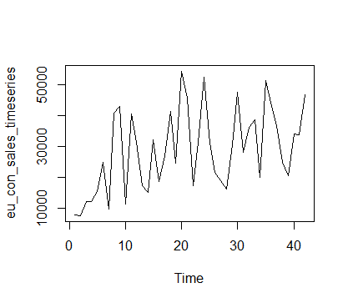
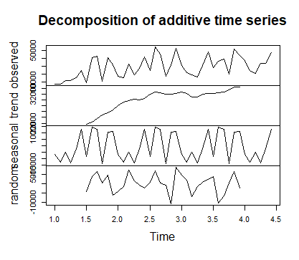
Decompose EU SALES AMT Time series
The EU Sales Qty Time Series has additive components as seen from time series plot
The decomposed time series shows a linear trend and low amplitude sinusoidal seasonal behaviour -15000 to 15000

Slide 19
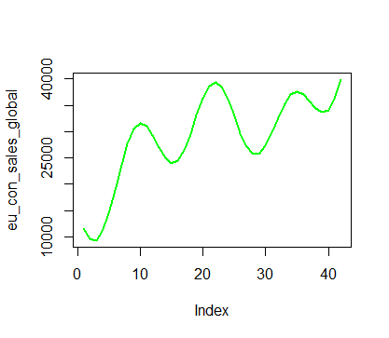
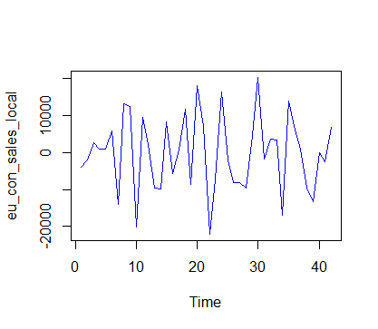
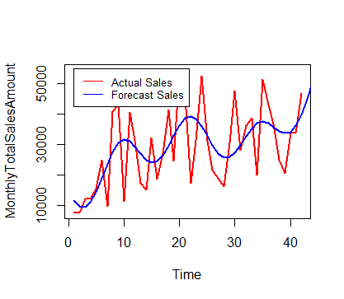
EU SALES AMT FORECAsting:
Classical decomposition method:
The Global component shows increasing trend
The Local component shows seasonality
The Classical Decomposition method on Test set yielded a MAPE of 30.69%

Slide 20

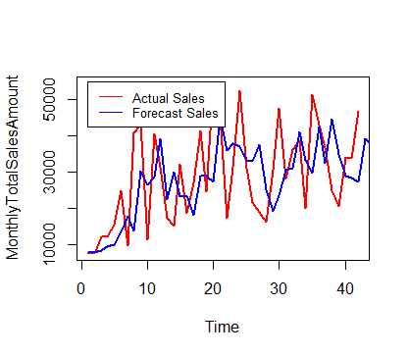
EU sales AMT forecast AUTO ARIMA method:
The ARIMA method on Test set yielded a MAPE of 28.9%
The residuals pass the stationarity tests

Slide 21
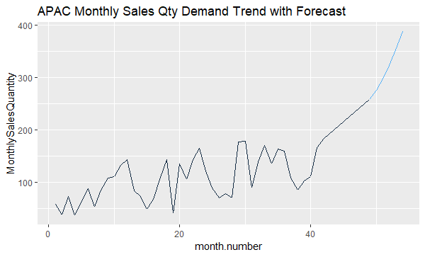
APAC Monthly Sales Qty forecast for next 6 months using classical decomposition
We can see the APAC Monthly Sales QTY for next 6 months will increase (forecast in blue)

Slide 22
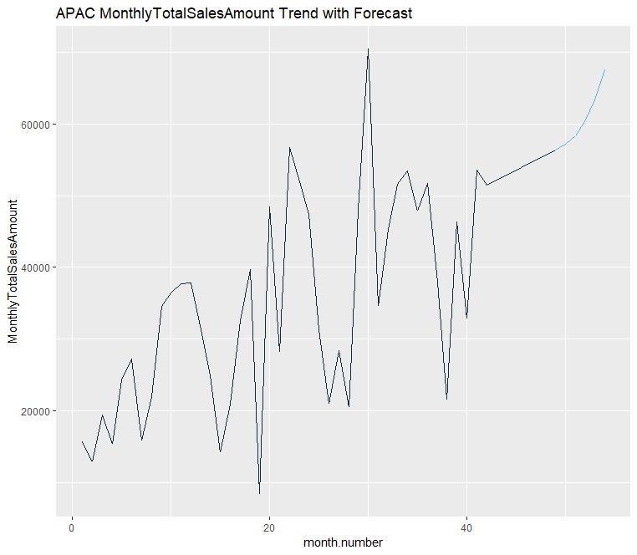
APAC Monthly Sales aMT forecast for next 6 months using classical decomposition
We can see the APAC Monthly Sales amount forecast for next 6 months will increase (in blue)

Slide 23
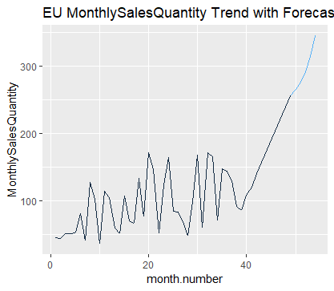
EU Monthly Sales Qty forecast for next 6 months using classical decomposition
We can see the EU Monthly Sales QTY will increase for next 6 months (forecast in blue)

Slide 24
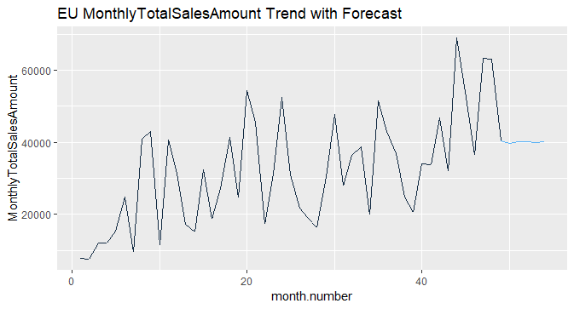
EU Monthly Sales AMT forecast for next 6 months using AUTO.ARIMa
We can see the EU Monthly Sales Amount will increase for next 6 months (forecast in blue)

Slide 25
CONCLUSION:
APAC Consumer and EU Consumer are the most profitable buckets.
Sales across the markets shown seasonal behavior and increasing trend
Classical Decomposition Method worked better than Arima in all cases for most ( three) cases.

